Slide 1
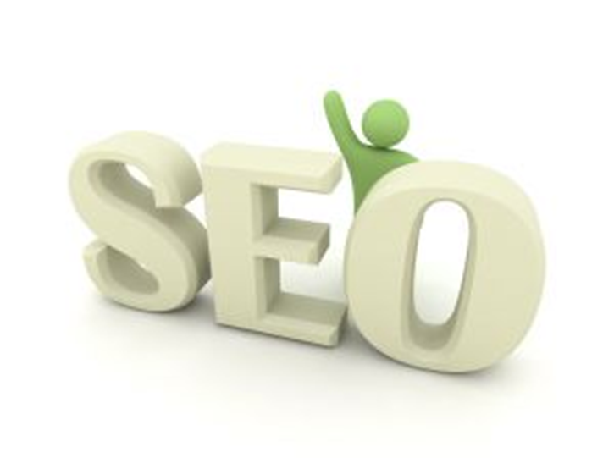
Basic Search Engine Optimization

Slide 2
What is SEO?
SEO is an abbreviation for search engine optimization.

Slide 3
What is SEO?
SEO is an abbreviation for search engine optimization.
SEO is the process of improving the volume or quality of traffic to a web site from search engines via Natural (organic) search results.

Slide 4
What is SEO?
SEO is an abbreviation for search engine optimization.
SEO is the process of improving the volume or quality of traffic to a web site from search engines via Natural (organic) search results.
SEO aims to improve rankings for relevant keywords in search results.

Slide 5
What is SEO?
SEO is an abbreviation for search engine optimization.
SEO is the process of improving the volume or quality of traffic to a web site from search engines via Natural (organic) search results.
SEO aims to improve rankings for relevant keywords in search results.
Organic SEO results account for over 80% of clicks.

Slide 6
Why are search engines so important?
Search engines are the biggest resources of your websites traffic.

Slide 7
Why are search engines so important?
Search engines are the biggest resources of your websites traffic.
Higher traffic means more visitors.

Slide 8
Why are search engines so important?
Search engines are the biggest resources of your websites traffic.
Higher traffic means more visitors.
More visitors means more customers and higher profit.

Slide 9
When will I see results?
It depends:
On your industry

Slide 10
When will I see results?
It depends:
On your industry
The competitive level of your keywords

Slide 11
When will I see results?
It depends:
On your industry
The competitive level of your keywords
The previous success of your website

Slide 12
When will I see results?
It depends:
On your industry
The competitive level of your keywords
The previous success of your website
Subject to the search engines updating their data

Slide 13
When will I see results?
It depends:
On your industry
The competitive level of your keywords
The previous success of your website
Subject to the search engines updating their data
You may see minor results change in 30 days.

Slide 14
When will I see results?
It depends:
On your industry
The competitive level of your keywords
The previous success of your website
Subject to the search engines updating their data
You may see minor results change in 30 days.
A significant frequency of top 10 and top 20 rankings can be seen within approximately 3-4 months if optimized correctly.

Slide 15
SEO Process

Slide 16
Types of SEO
On-Page Optimization
Off-page Optimization

Slide 17
On-Page SEO
On-page optimization (on-page SEO) is what can be done on the pages of a website to maximize its performance in the search engines for target keywords related to the on-page content.

Slide 18
On-Page SEO
On-page optimization (on-page SEO) is what can be done on the pages of a website to maximize its performance in the search engines for target keywords related to the on-page content.
On-page optimization stands for all of the techniques and methods used on your website.

Slide 19
On-Page SEO
On-page optimization (on-page SEO) is what can be done on the pages of a website to maximize its performance in the search engines for target keywords related to the on-page content.
On-page optimization stands for all of the techniques and methods used on your website.
On-page optimization has an effect on your website listing in natural results .

Slide 20
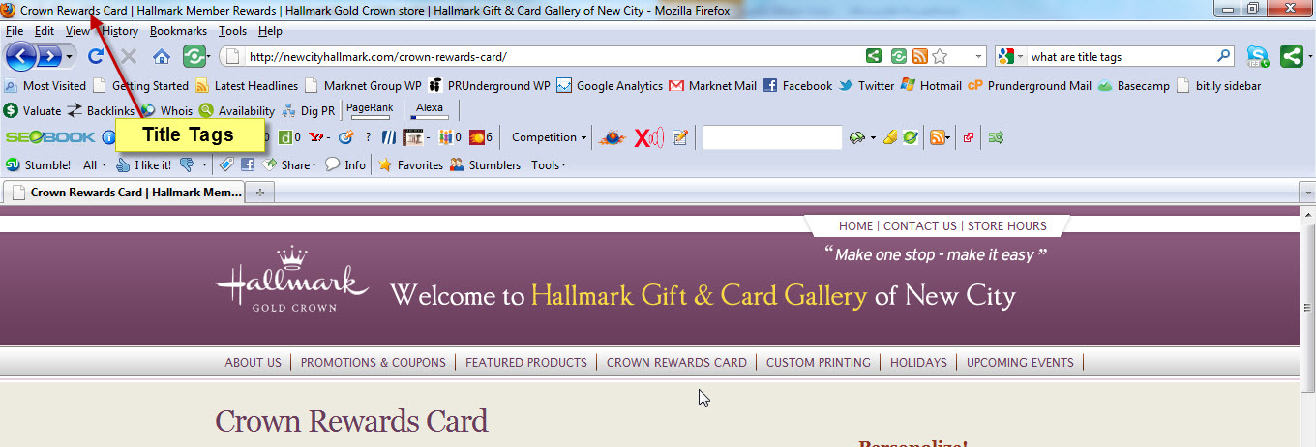
On-Page SEO Elements
Title Tags
Defines a title in the browser toolbar
Provides a title for the page when it is added to favorites
Displays a title for the page in search-engine results

Slide 21
On-Page SEO Elements
Meta Tags
Gives Google and other search engines a summary of what the page is about

Slide 22
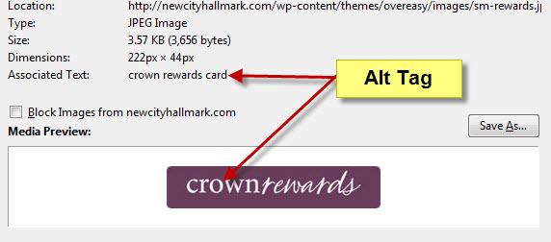
On-Page SEO Elements
Alt Tags
Allows you to provide a text equivalent to the image.

Slide 23
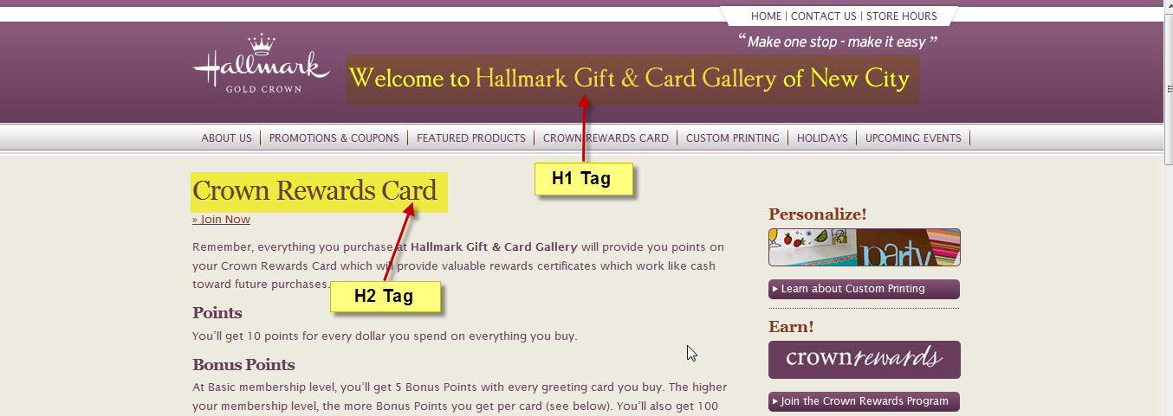
On-Page SEO Elements
Header(H1,H2) Tags
There are six sizes of heading tags, beginning with <h1>, the most important, and ending with <h6>, the least important (1).

Slide 24
On-Page SEO Elements
URL Structure
An optimal URL structure will not use numbers or strange characters on the permalinks, it will be short and describe the content of the page.

Slide 25
On-Page SEO Elements
Internal Linking
Internal linking is linking to resources that are inside the website

